Slide 1
Introduction to Record Linkage
(thanks to Manfred Antoni, Stefan Bender, Joseph Sakshaug, Josh Tokle)

Slide 2
Structure of the day
9:00-9:30 Introductions
9:30-10:30 Lecture
10:30-11:00 Break
11:00-11:30 Python set-up
11:30-12:00 Hands on datasets
12:00-100 Lunch
1:00-1:30 Basics of databases and overview of schema
1:30-2:00 Intro to cleaning
2:30-3:00 Initial summary statistics
2:30-3:00 Break
3:00-4:00 Standardization and deterministic matching
4:00-4:30 Update summary stats
4:30-5:00 discussion & closing

Slide 3
Overview
Context
Basics of Processing
Blocking
Linkage Approaches
Evaluation

Slide 4
Overview
Context
Basics of Processing
Blocking
Linkage Approaches
Evaluation

Slide 5
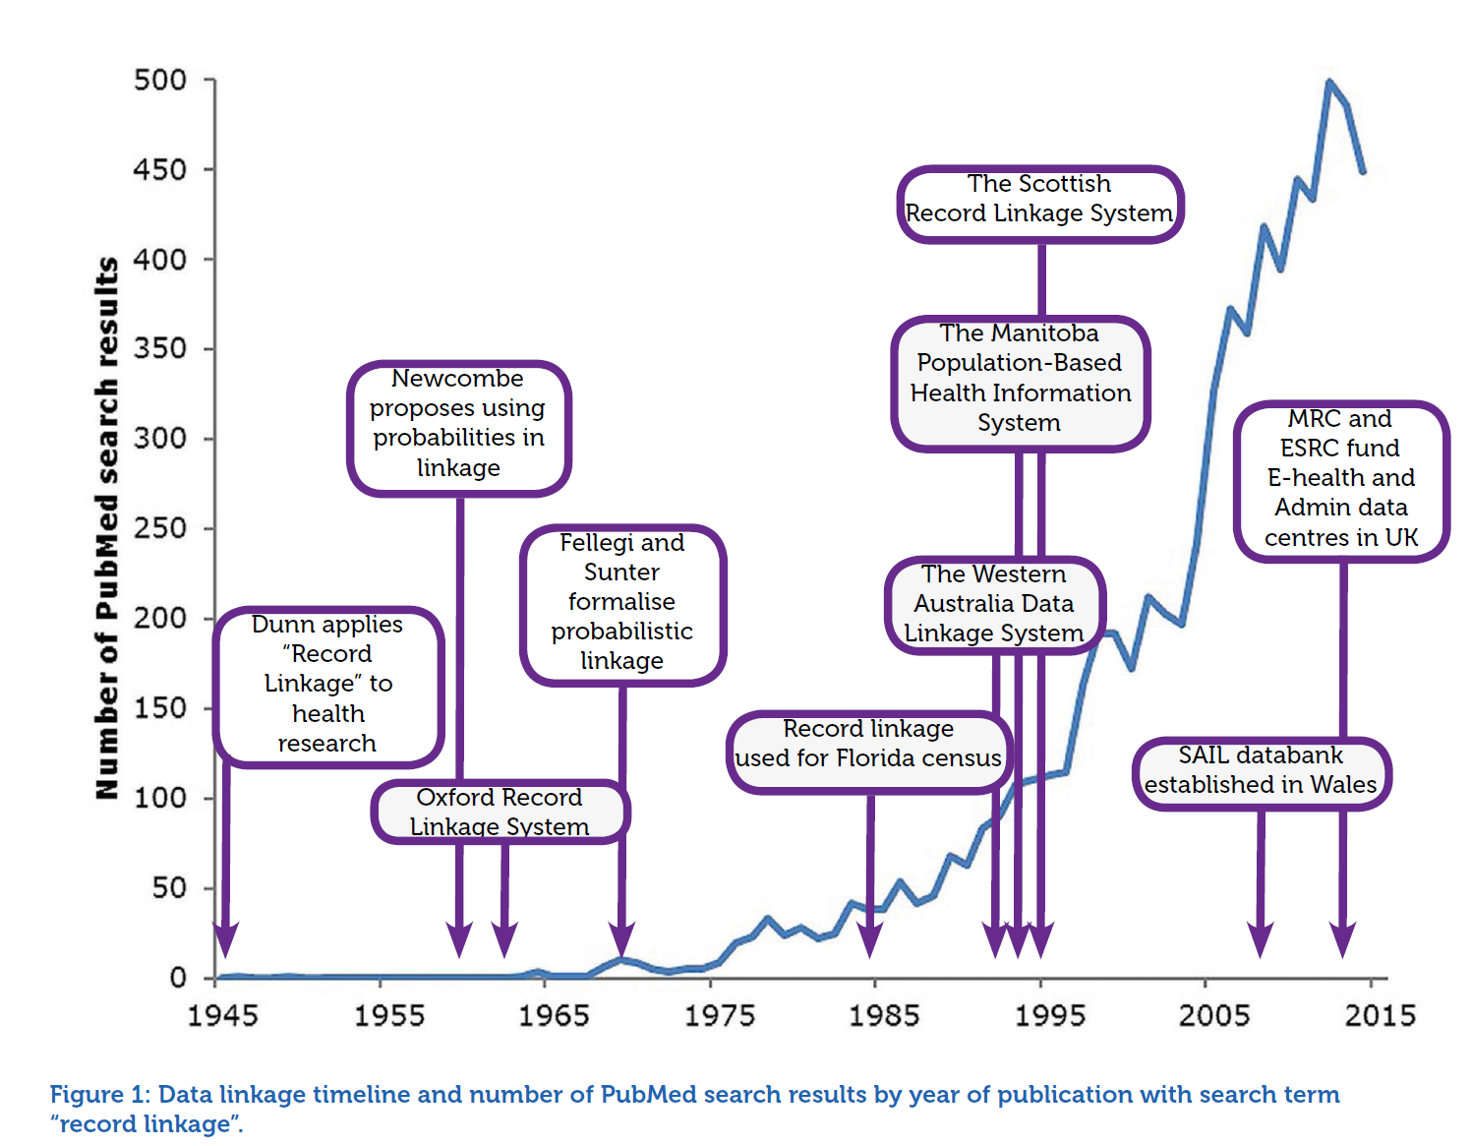
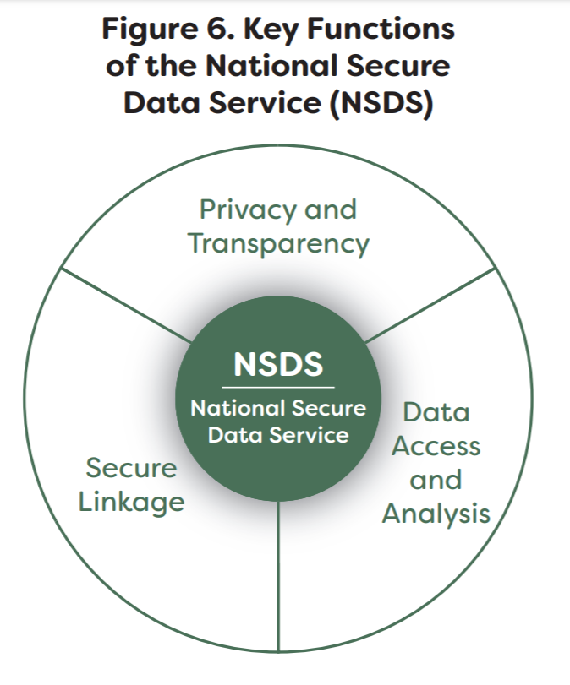
Katie Herron: Introduction to Data Linkage

Slide 6
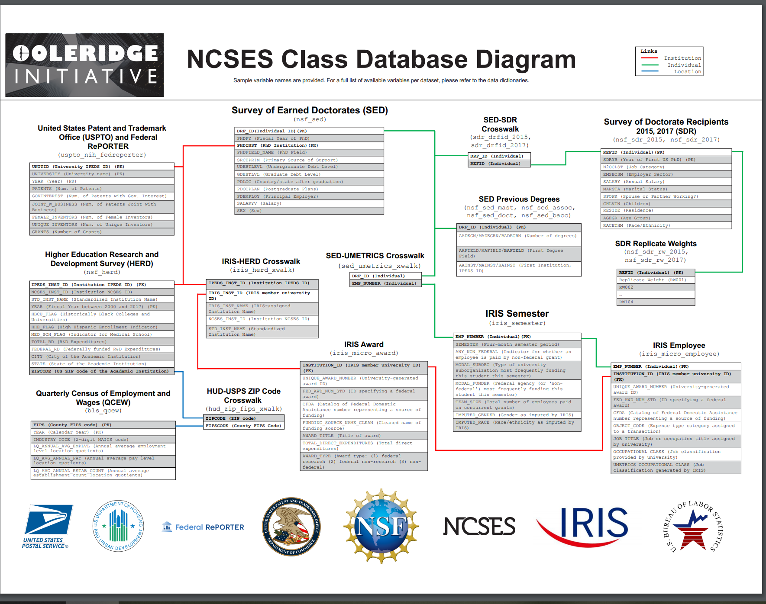
Example Dataset Overview (your work is subset)

Slide 7
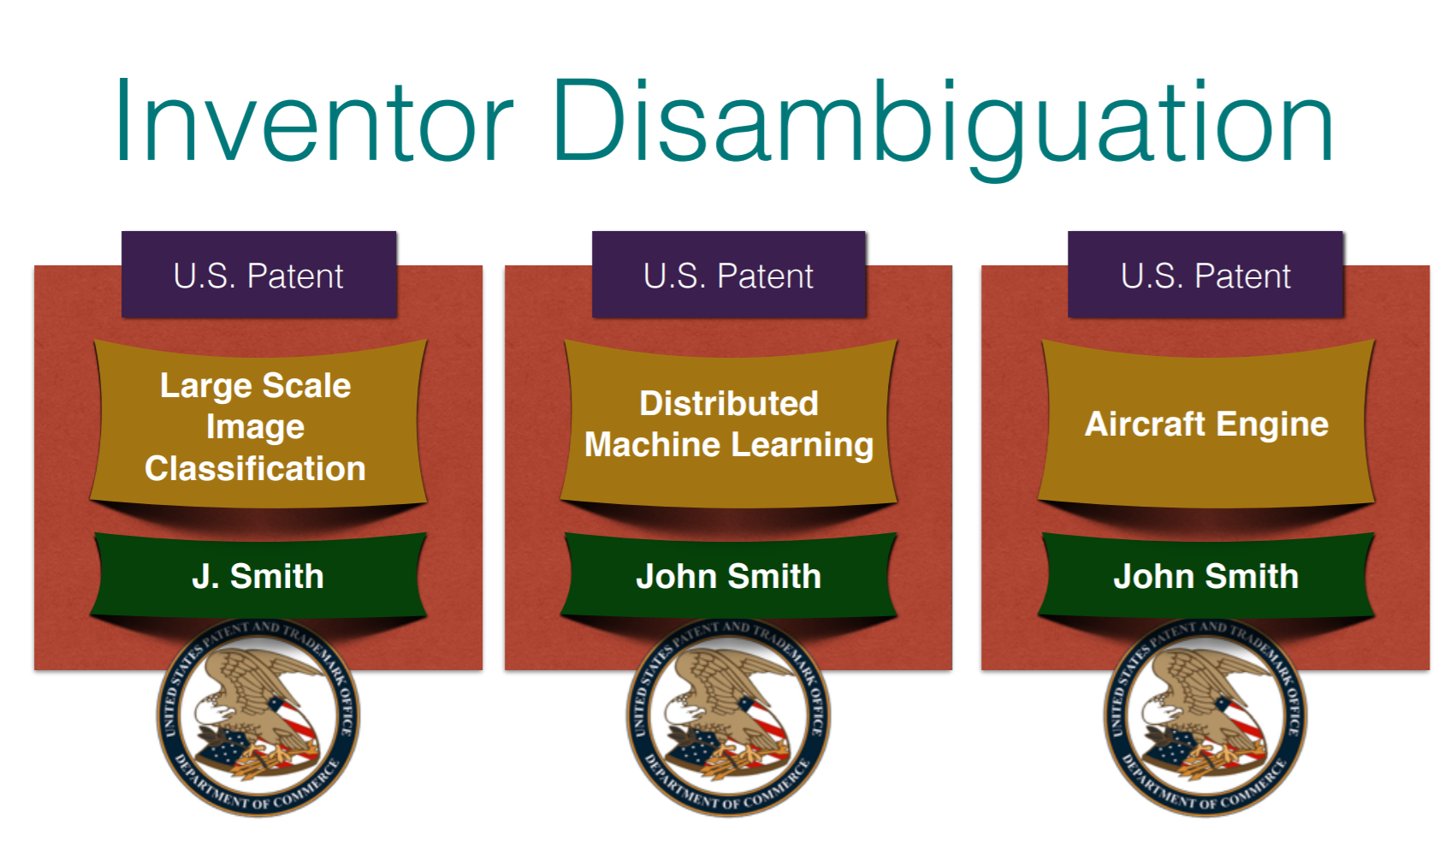
Example of Challenges

Slide 8
Many Terms
Computer science
Data matching
Object identity problem
Object consolidation
Database community
Merge-purge / list washing
Duplicate detection
Others
Identity uncertainty
Entity/reference resolution
Entity/reference disambiguation
Approximate matching

Slide 9


Motivation: The New Zealand context
Health
NZ Super
Social security and welfare
Education
Other
Core Governmentservices
Finance costs
Transport and communication
Law and order
Defence
Budget 2018
Budget 2018

Slide 10


What do we mean by integrated data?
1 | 2 | 3 | 4 | 5 | 6 | 7 | 8 | 9 | 10 | 11 | 12 | 13 | 14 | 15 | 16 | 17 | 18 | 19
^{Aged}
^{CYFS}
^{Abuse Findings}
^{Care}
^{Education}
^{Youth Justice}
^{Income support}
^{Total cumulative paid ($1000)}
 |  | 6 |  |  |  | 18 |  |  | 37 |  |  | 53 | 58 | 71 | 120 | 126 | 127 | 142

Slide 11
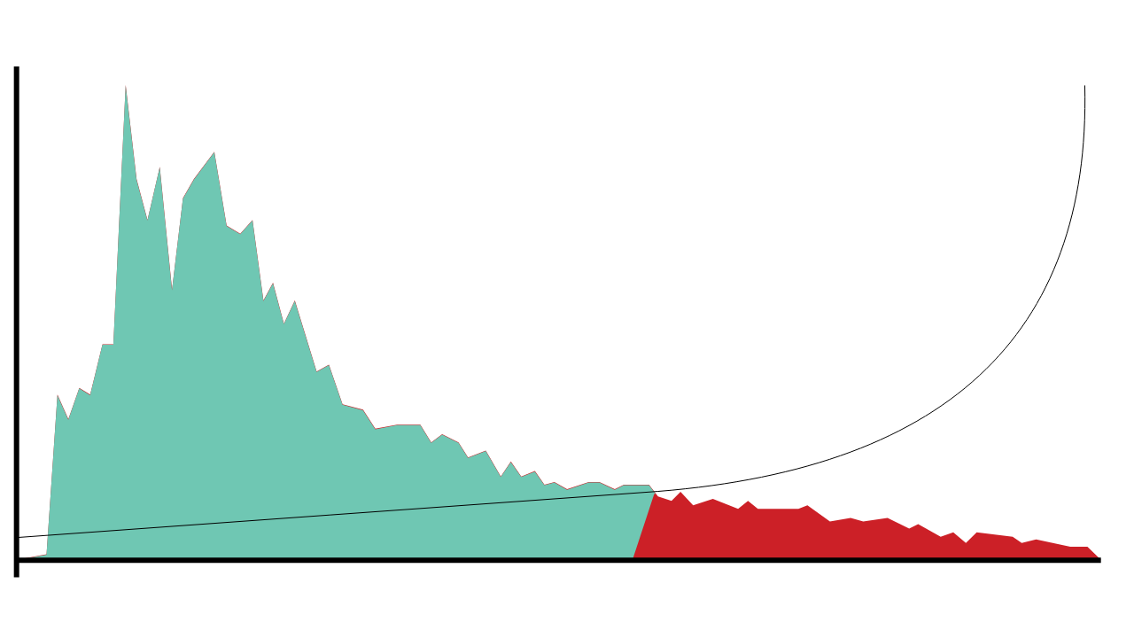

Understanding risk
The risk profile of this cohort reveals a long tail of increased risk.
2,500
The hypothetical cost effectiveness of interventions increases when they are delivered to the students who need them most.
48,077 low-risk students have an average risk of 27%
Number of students
1,250
6,990 high risk students have an average risk of 76%
0
0%
100%
Risk of not achieving NCEA2 by age 18

Slide 12
Aggregate liability valuation
Total liability
72.2 billion
$13.7 billion​
Increase due to policy package to reduce child poverty – because of the method we employ, this can be isolated
Liability decrease related to experience, $billions
Liability reduction
attributable to system reform
Updated model assumptions
Client numbers

Slide 13

Cohort liability estimates
Of that $72.2 billion, 75% is attributable to clients who entered the benefit system under the age of 20.
High-liability cohorts include:
Sole parents
People who churn in and out of the benefit system
Ex-prisoners on release
Young people with disabilities or chronic conditions, who want to work but need support to do so.

Slide 14
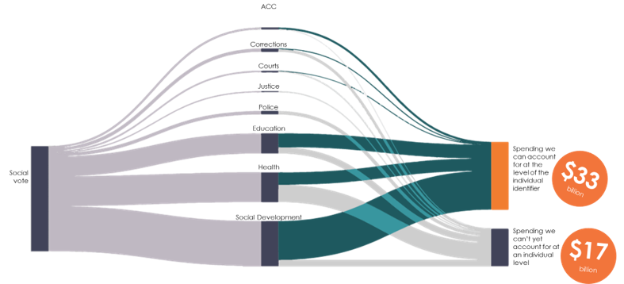
Understanding return on investment
We're able to link two thirds of service costs to individuals

Slide 15

The challenge of system-wide change
Welfare
Valuation – welfare
Feasibility study
Social housing
Feasibility study
Valuation – social housing
Justice
Feasibility study
Crime model
Vulnerable children
Feasibility study
Valuation
Education, health
Pre-feasibility
2011
2012
2013
2014
2015
2016

Slide 16

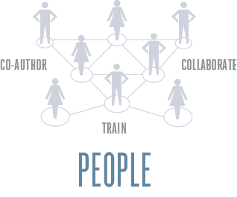

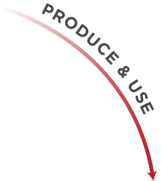






In our context

Slide 17

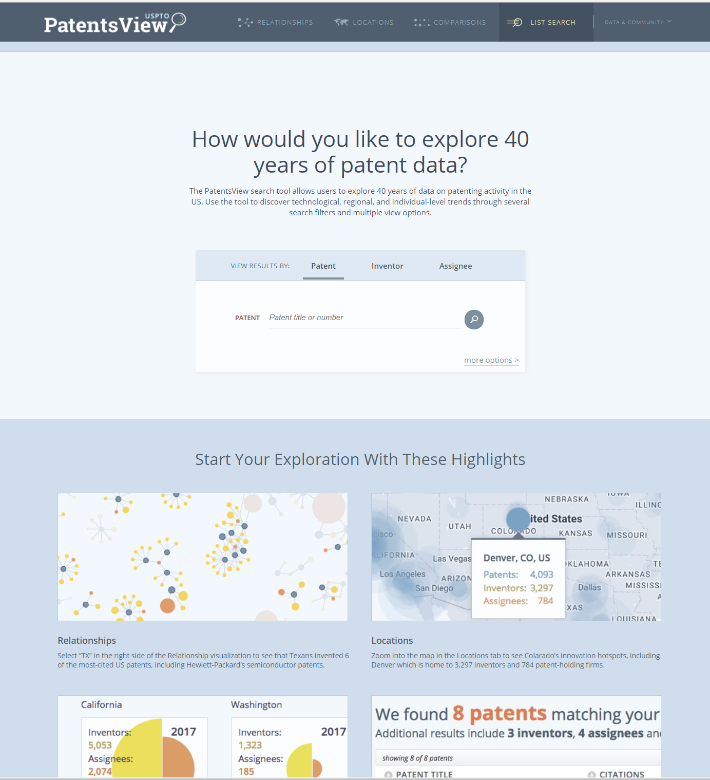
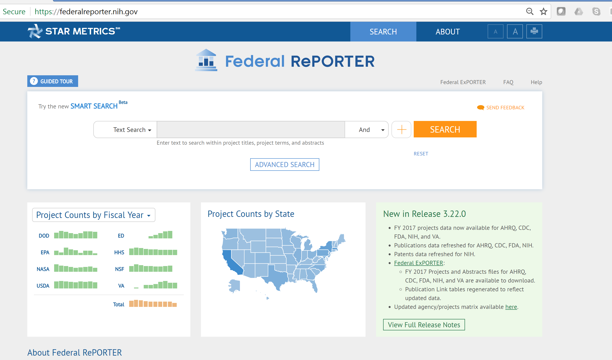
In our context

Slide 18
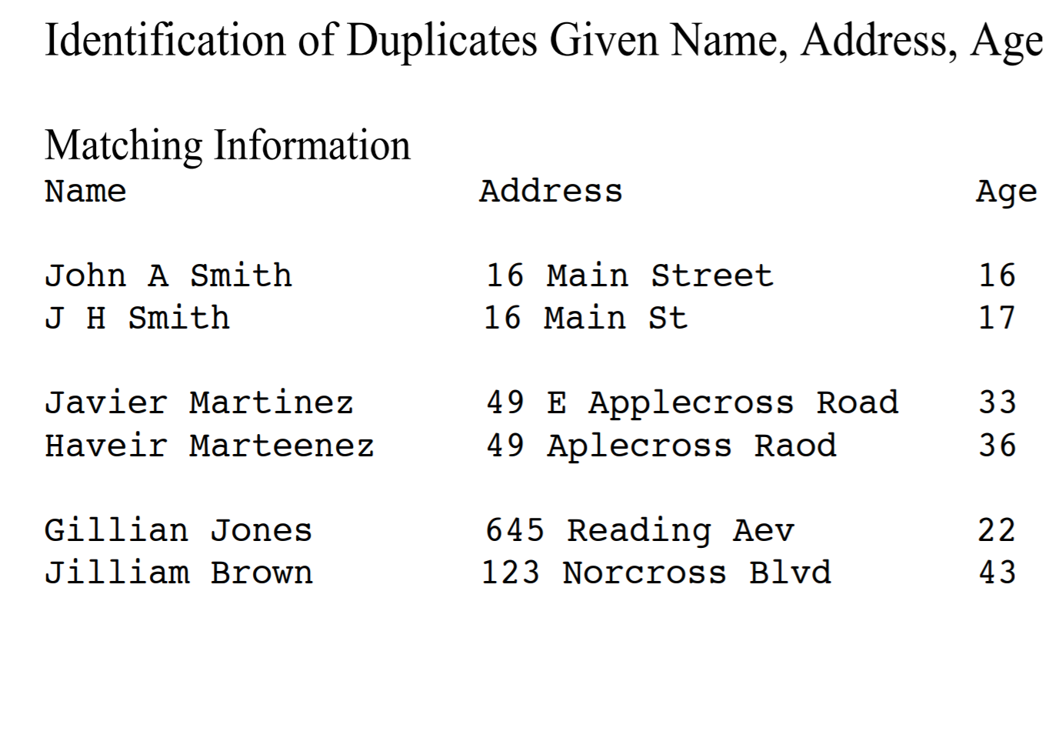
Canonical Problem

Slide 19
Overview
Context
Basics of Processing
Blocking
Linkage Approaches
Evaluation

Slide 20
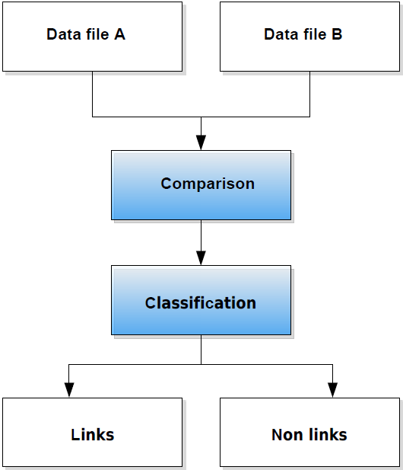
The basic record linkage process (Bender et al. 2015)

Slide 21
There is no perfect world
In a perfect world
But we do not live in a perfect world
Predicted
True Positive (TP)
 | True Negative (TN)
True
Predicted
True Positive (TP) | False Negative (FN)
False Positive (FP) | True Negative (TN)
True

Slide 22
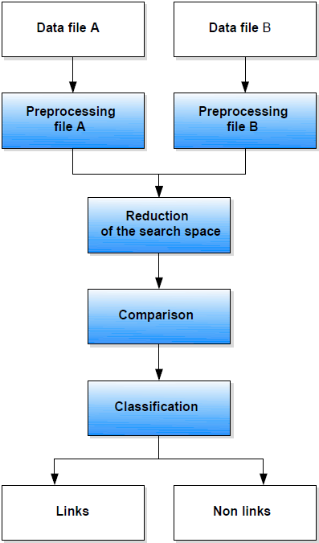
The extended RL process (Bender et al. 2015)

Slide 23
Shares of effort within linkage process
5% matching and linking efforts
20% checking that the computer matching is correct
75% cleaning and parsing the two input files
(Gill 2001, p. 31)

Slide 24
Preprocessing Basics
Typical identifiers:
People: first and last name, address, birth date, sex
Establishments / firms: name, legal form, address
The higher the number of different manifestations of an identifier, the better its suitability for a comparison.
Complex identifiers should be parsed into its separate components
Means of getting clean identifiers in the first place

Slide 25
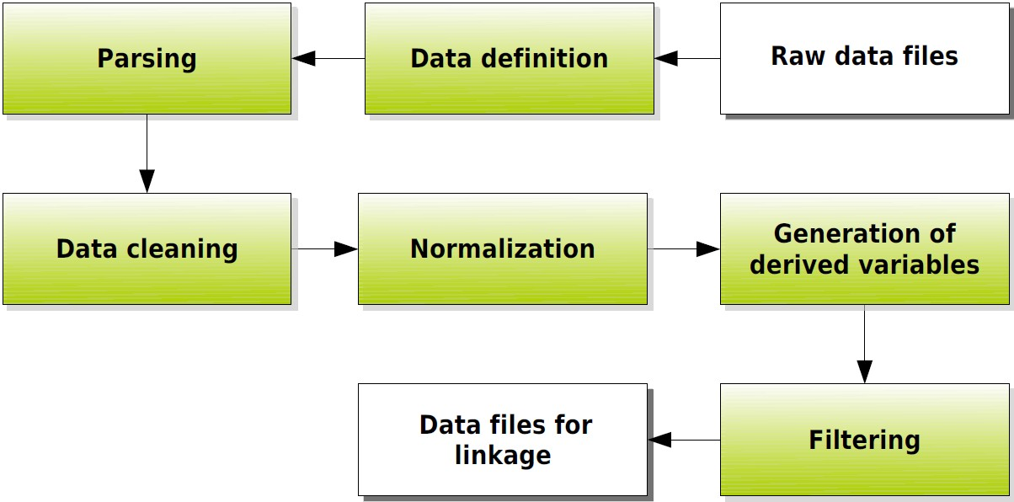
Data Preprocessing

Slide 26
Data Definition
Identify attributes :
1. Variable name, variable type, data type, missing code
2. For continuous variables: Allowed range
3. For coded categorical variables: Code list
4. For uncoded variables (respectively name variables)
regular length
regular pattern
allowed character set
excluded rules
is a list of permissible values available?

Slide 27
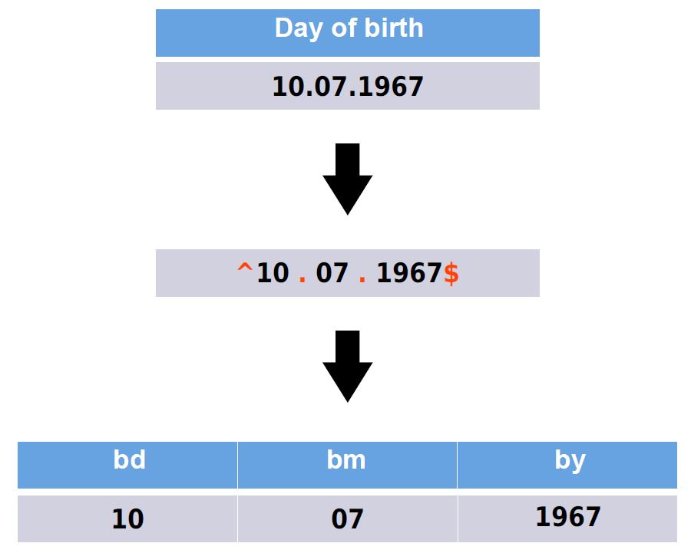

Slide 28
Parsing II
Decompose into predefined components using predefined rules
Typical procedure:
Split fields into tokens (words) on basis of delimiters
Standardize tokens by lookup tables
Categorize tokens
Identify pattern of anchors, tokens and delimiters

Slide 29
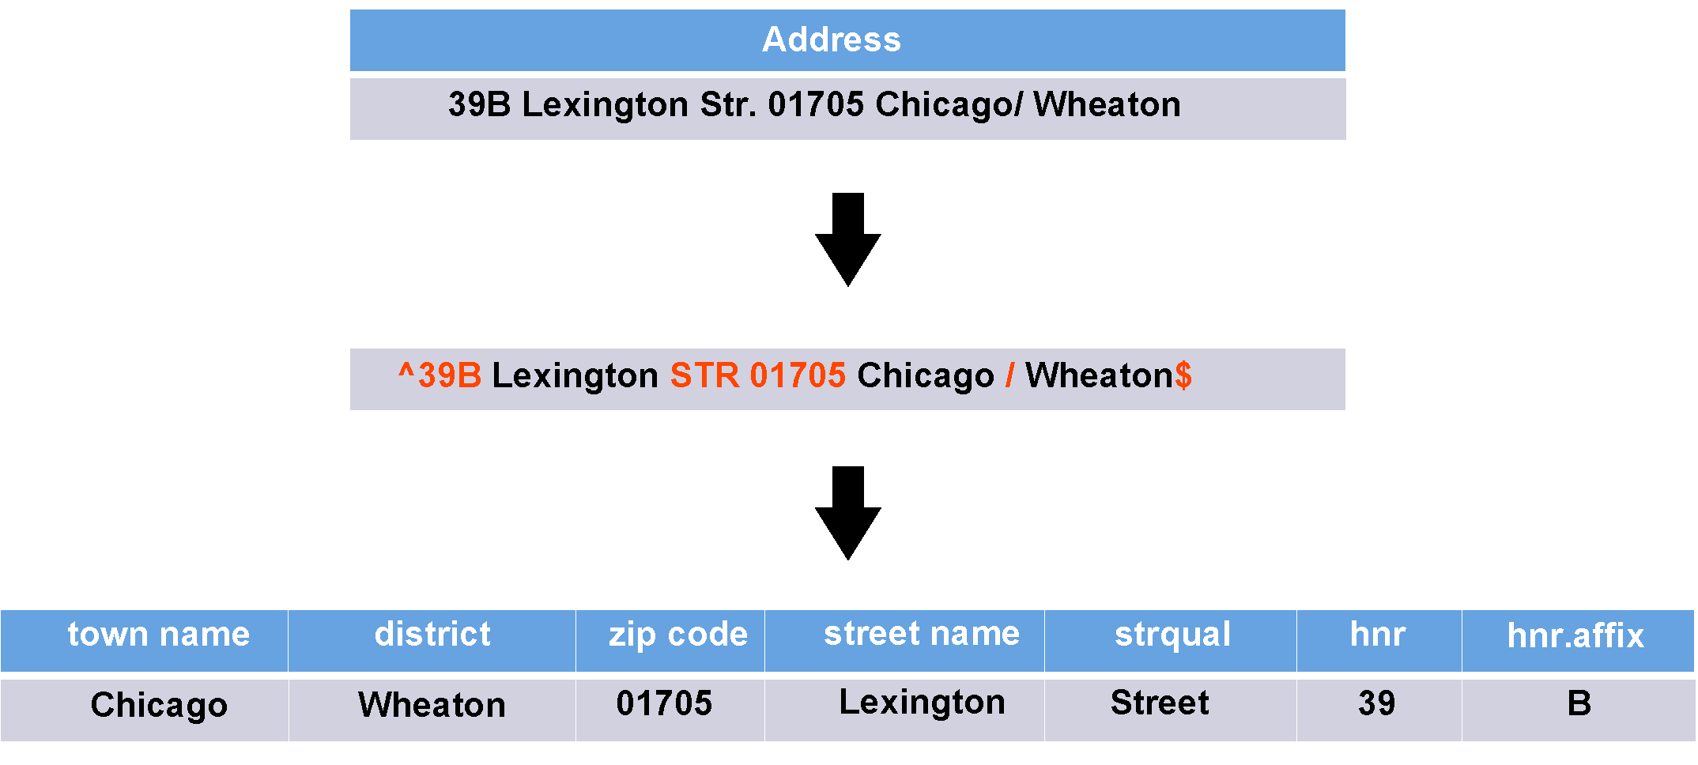

Slide 30
Example of Parsing
Parsing Out Zipcode:
Parsing Out Street Prefix:
Business Address | Zjpcode
424 Main Street, 63210 | 63201
Business Address | Street Prefix
21 W 14th Street, 62345 | W

Slide 31
Data Cleaning
Evaluation of identifiers against data definition
Checking plausibility of variable values
Checking records for consistency
Standardization
Deduplication

Slide 32
Preprocessing data
Normalization:
Lowercasing
Removing punctuation and special characters
Removing white space
e.g. Texas A&M University -> texasamuniversity
Phonetic transcriptions (soundex)

Slide 33
Preprocessing data
“In situations of reasonably high-quality data, preprocessing can yield a greater improvement in matching efficiency than string comparators and ‘optimized’ parameters. In some situations, 90% of the improvement in matching efficiency may be due to preprocessing” (Winkler 2009)¹.
Issues:
misspellings, typos (Leland Standford Junior Univsersity, Leland Standard Univ.)
abbreviated forms (Stanford Univ., Stanford Univ, Leland Stanford Jr. University)
name variants (Stanford University, Leland Stanford Junior University, The Board of Trustees of the Leland Stanford Junior University, The Regents of the Stanford Leland Junior University)
¹ Winkler, William E. 2009. “Record Linkage.” In Handbook of Statistics 29a, Sample Surveys: Design, Methods and Applications, edited by D. Pfeffermann and C. R. Rao, 351–80. Elsevier.

Slide 34
Overview
Context
Basics of Processing
Blocking
Linkage Approaches
Evaluation

Slide 35
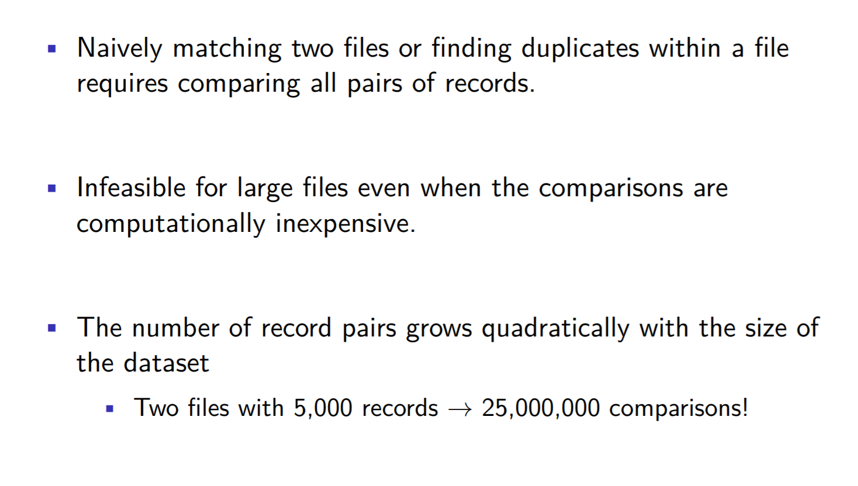
Blocking

Slide 36
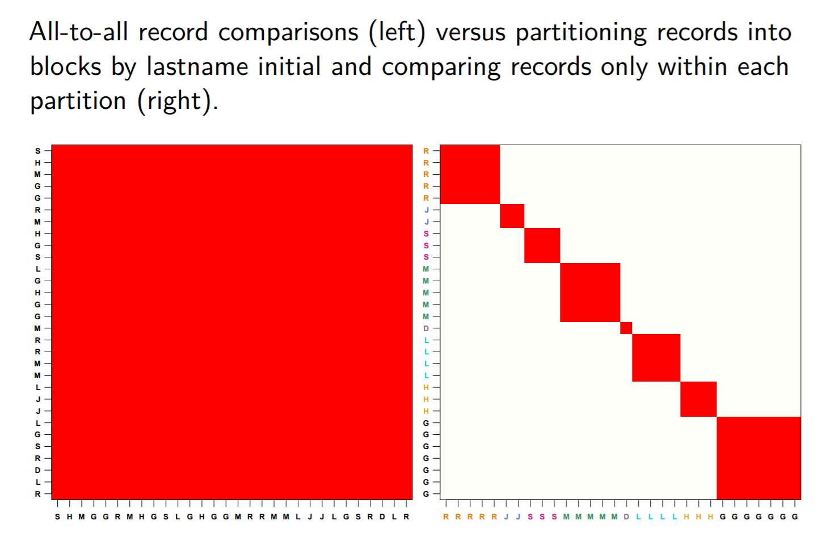
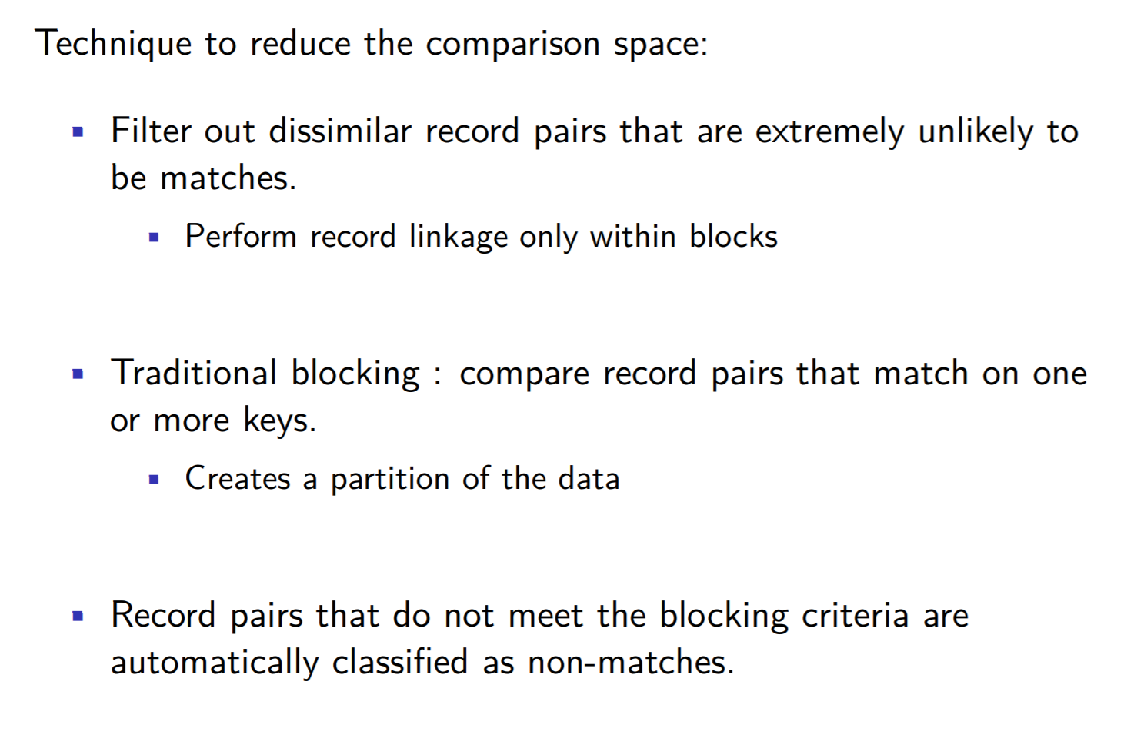
Blocking (continued)

Slide 37
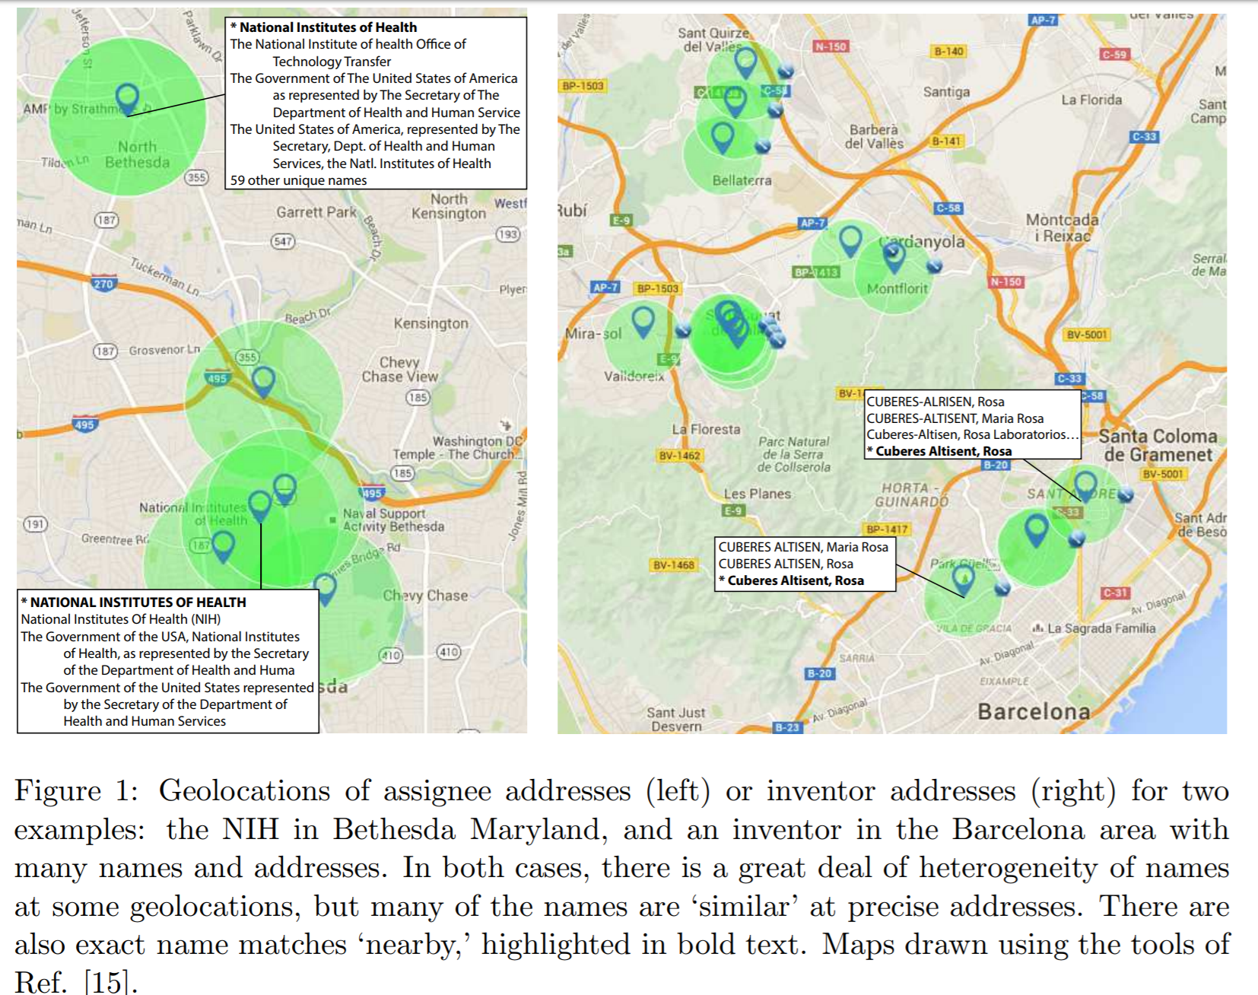
Disambiguation of Patent Inventors and Assignees Using High-Resolution Geolocation Data
Greg Morrison, Massimo Riccaboni, Fabio Pammolli; arXiv:1601.01963 [cs.DL]

Slide 38
Overview
Context
Basics of Processing
Blocking
Linkage Approaches
Rule based
Probabilistic
Machine Learning
Evaluation

Slide 39
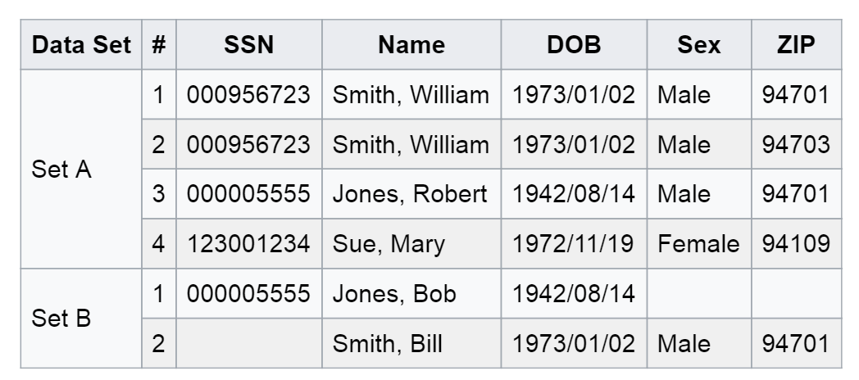
Deterministic (rule based) linkage
simplest method of matching
sort/merge exact match
works best with single unique identifier (key)
Identifiers
have equal weight
chosen by researcher or availability
Works well if keys are perfect and present in all datasets you want to link. In Example one key not enough (missing data), next key (name) has errors in it
Example: https://en.wikipedia.org/wiki/Record_linkage

Slide 40
Overview
Context
Basics of Processing
Blocking
Linkage Approaches
Evaluation

Slide 41
Summary: Record Linkage Technique (Christen 2015)
Deterministic matching
Rule-based matching (complex to build and maintain)
Probabilistic record linkage (Fellegi and Sunter, 1969)
Use available attributes for linking (often personal information, like names, addresses, dates of birth, etc.)
Calculate match weights for attributes
“Computer science” approaches
Based on machine learning, data mining, database, or information retrieval techniques

Slide 42
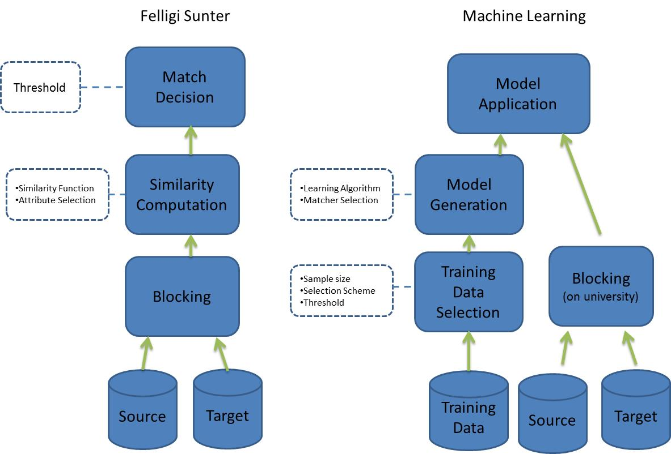
Approaches to linking:
Probabilistic vs Machine Learning

Slide 43
Overview
Context
Basics of Processing
Blocking
Linkage Approaches
Evaluation

Slide 44

Evaluation
Two types of accuracy errors.
A Type I error occurs when a true nonmatch is classified as a match.
A Type II error occurs when a true match is classified as a nonmatch.
Minimizing these errors is critical, particularly when the product will be used in a cohort study
Four metrics most often used to evaluate the accuracy of a linkage algorithm are:
Sensitivity TP / (TP+FN) – correct classification of true matches
Specificity FP / (FP+TN) – correct classification of true non matches
positive predictive value (PPV) TP / (TP + FP) – proportion of matched pairs classified as matches that are true matches
negative predictive value(NPV). TN / (FN + TN) – proportion of matched pairs classified as non matches that are true non matches

